Slide 1
Bubble sort VS Merge sort

Slide 2
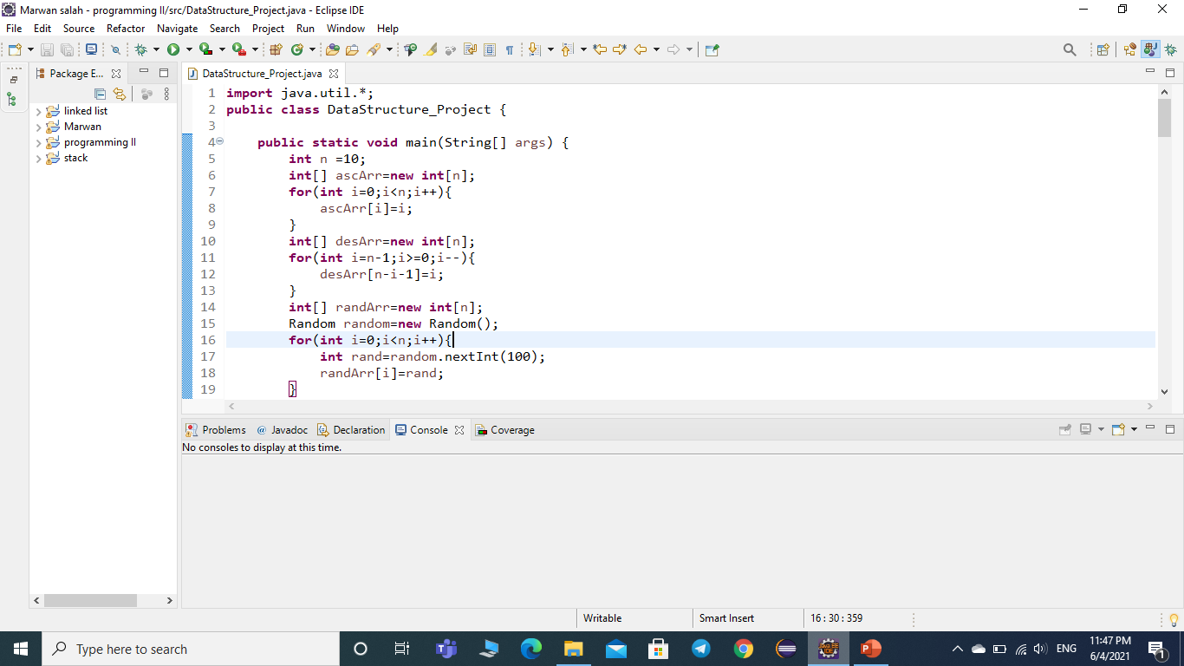

Slide 3
1)Importing util library(contains some array methods and random method that will be used to generate the random array)
2)Class named “DataStructure_Project”
4)Declaring main
5)Declaring variable of type integer named n=10 (Array size for all test cases)
6)Declaring an array of integers which is ascendingly filled from 0→9
7)For loop to fill the array
10)Declaring an array of integers which is descendingly filled from 9→0
11)For loop to fill the array
14)Declaring an array of integers which is Generated randomly
15)Creating an object of type random called “random”
16)For loop to fill the array randomly
17)Declaring variable of type integer called “rand” to generate a random integer from 0→100

Slide 4
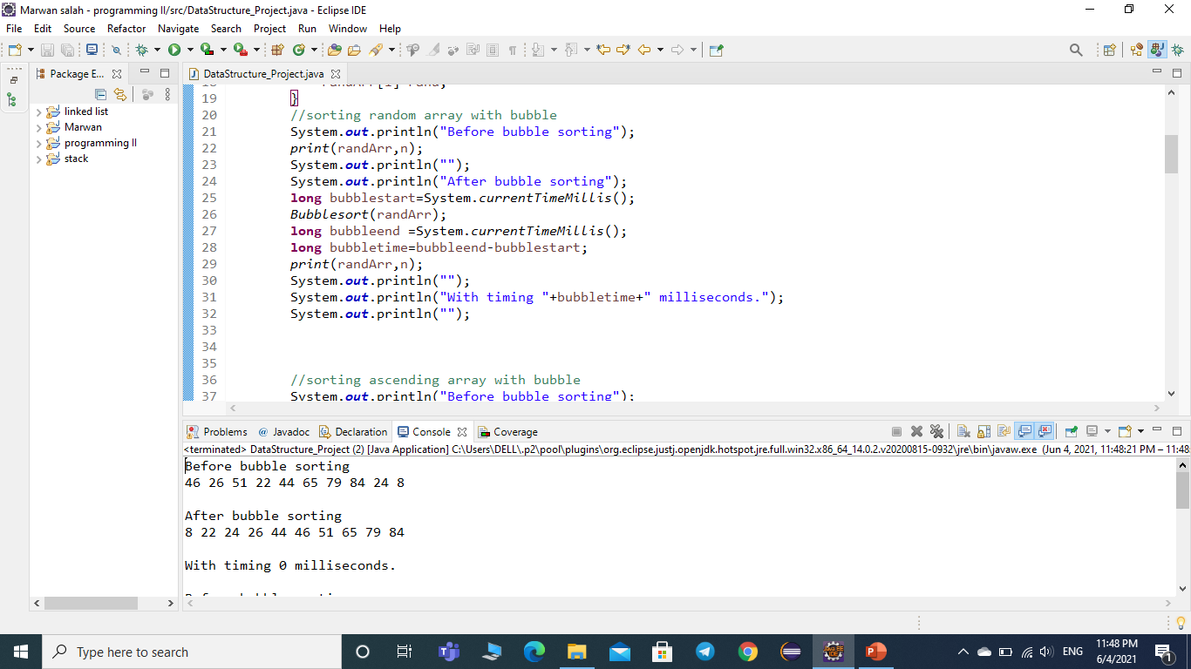

Slide 5
SORTING RANDOM ARRAY WITH BUBBLE SORT
21)Print “before bubble sorting”
22)Sending random array and it’s size n to static method called “print”
That prints the array
23)Printing an empty line
24)Print “after bubble sorting”
25)Declaring variable of type long to measure time complexity using “system.currenttimemillis()”
26)Sort the array by passing it as parameter to “Bubblesort” method
27) Declaring variable of type long to measure time complexity using “system.currenttimemillis()”
28)Measuring the time complexity by calculating the difference of time between start time of sorting and ending time
29) Sending random array and it’s size n to static method called “print”
That prints the array AFTER SORTING
30) Printing an empty line
31) Printing the time complexity of array sorting
32) Printing an empty line

Slide 6
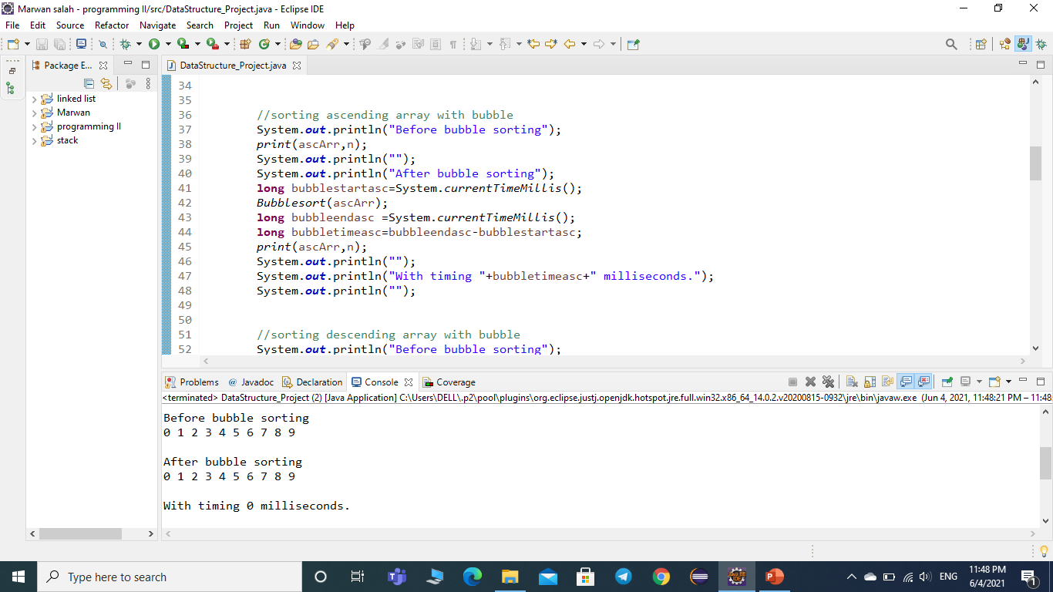

Slide 7
SORTING ASCENDING ARRAY WITH BUBBLE SORT
37)Print “before bubble sorting”
38)Sending ascending array and it’s size n to static method called “print”
That prints the array
39)Printing an empty line
40)Print “after bubble sorting”
41)Declaring variable of type long to measure time complexity using “system.currenttimemillis()”
42)Sort the array by passing it as parameter to “Bubblesort” method
43) Declaring variable of type long to measure time complexity using “system.currenttimemillis()”
44)Measuring the time complexity by calculating the difference of time between start time of sorting and ending time
45) Sending the ascending array and it’s size n to static method called “print”
That prints the array AFTER SORTING
46) Printing an empty line
47) Printing the time complexity of array sorting
48) Printing an empty line

Slide 8
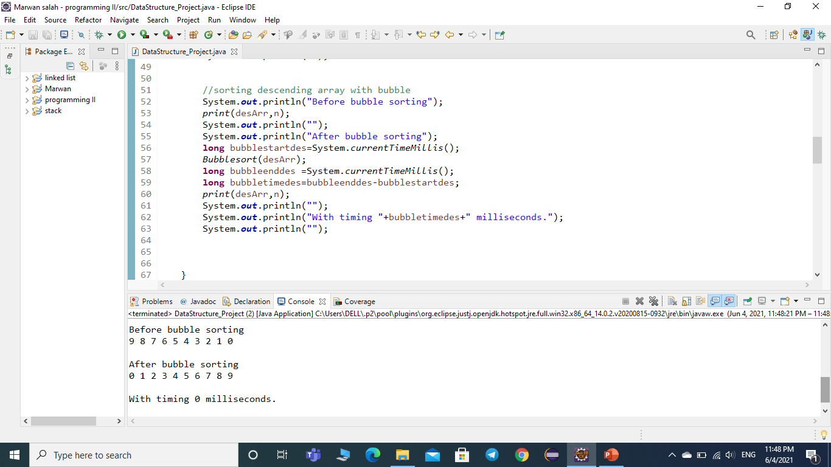

Slide 9
SORTING DESCENDING ARRAY WITH BUBBLE SORT
52)Print “before bubble sorting”
53)Sending descending array and it’s size n to static method called “print”
That prints the array
54)Printing an empty line
55)Print “after bubble sorting”
56)Declaring variable of type long to measure time complexity using “system.currenttimemillis()”
57)Sort the array by passing it as parameter to “Bubblesort” method
58) Declaring variable of type long to measure time complexity using “system.currenttimemillis()”
59)Measuring the time complexity by calculating the difference of time between start time of sorting and ending time
60) Sending the descending array and it’s size n to static method called “print”
That prints the array AFTER SORTING
61) Printing an empty line
62) Printing the time complexity of array sorting
63) Printing an empty line

Slide 10
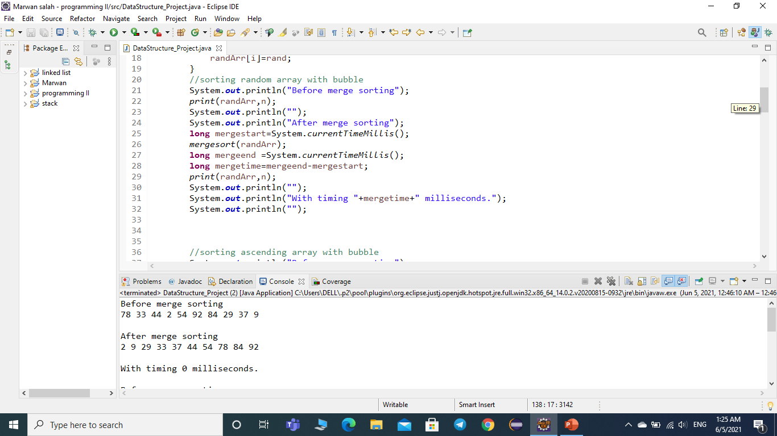

Slide 11
SORTING RANDOM ARRAY WITH MERGE SORT
21)Print “before merge sorting”
22)Sending random array and it’s size n to static method called “print”
That prints the array
23)Printing an empty line
24)Print “after merge sorting”
25)Declaring variable of type long to measure time complexity using “system.currenttimemillis()”
26)Sort the array by passing it as parameter to “mergesort” method
27) Declaring variable of type long to measure time complexity using “system.currenttimemillis()”
28)Measuring the time complexity by calculating the difference of time between start time of sorting and ending time
29) Sending random array and it’s size n to static method called “print”
That prints the array AFTER SORTING
30) Printing an empty line
31) Printing the time complexity of array sorting
32) Printing an empty line

Slide 12
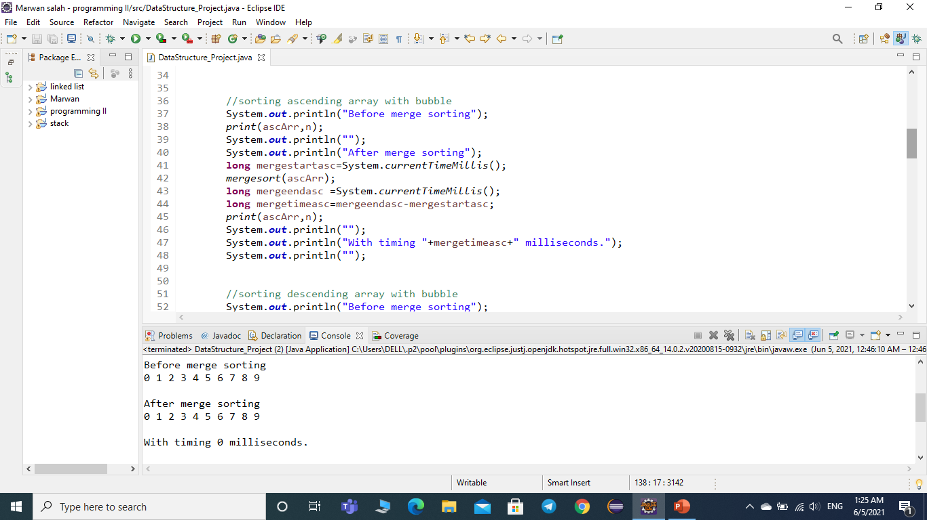

Slide 13
SORTING ASCENDING ARRAY WITH MERGE SORT
21)Print “before merge sorting”
22)Sending ascending array and it’s size n to static method called “print”
That prints the array
23)Printing an empty line
24)Print “after merge sorting”
25)Declaring variable of type long to measure time complexity using “system.currenttimemillis()”
26)Sort the array by passing it as parameter to “mergesort” method
27) Declaring variable of type long to measure time complexity using “system.currenttimemillis()”
28)Measuring the time complexity by calculating the difference of time between start time of sorting and ending time
29) Sending ascending array and it’s size n to static method called “print”
That prints the array AFTER SORTING
30) Printing an empty line
31) Printing the time complexity of array sorting
32) Printing an empty line

Slide 14


Slide 15
SORTING DESCENDING ARRAY WITH MERGE SORT
21)Print “before merge sorting”
22)Sending descending array and it’s size n to static method called “print”
That prints the array
23)Printing an empty line
24)Print “after merge sorting”
25)Declaring variable of type long to measure time complexity using “system.currenttimemillis()”
26)Sort the array by passing it as parameter to “mergesort” method
27) Declaring variable of type long to measure time complexity using “system.currenttimemillis()”
28)Measuring the time complexity by calculating the difference of time between start time of sorting and ending time
29) Sending descending array and it’s size n to static method called “print”
That prints the array AFTER SORTING
30) Printing an empty line
31) Printing the time complexity of array sorting
32) Printing an empty line

Slide 16
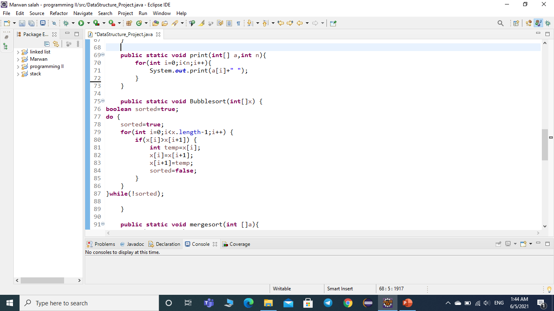

Slide 17
69) A static method that receives array and its length as parameters and prints it
70)For loop to print each element in the array
75) A static method to sort arrays with “bubble sort” method receives array as parameter
76)Declaring variable of type Boolean “sorted” and assigning it as TRUE
77)Do-while loop that is repeated as long as sorted is FALSE
78)Let sorted be TRUE
79)For loop repeated until the last element-1 in the array
80)If condition that checks if the element In index i greater than element in index i+1
81,82,83)If true swap x[i] with x[i+1]
84) Let sorted be false to go another iteration

Slide 18
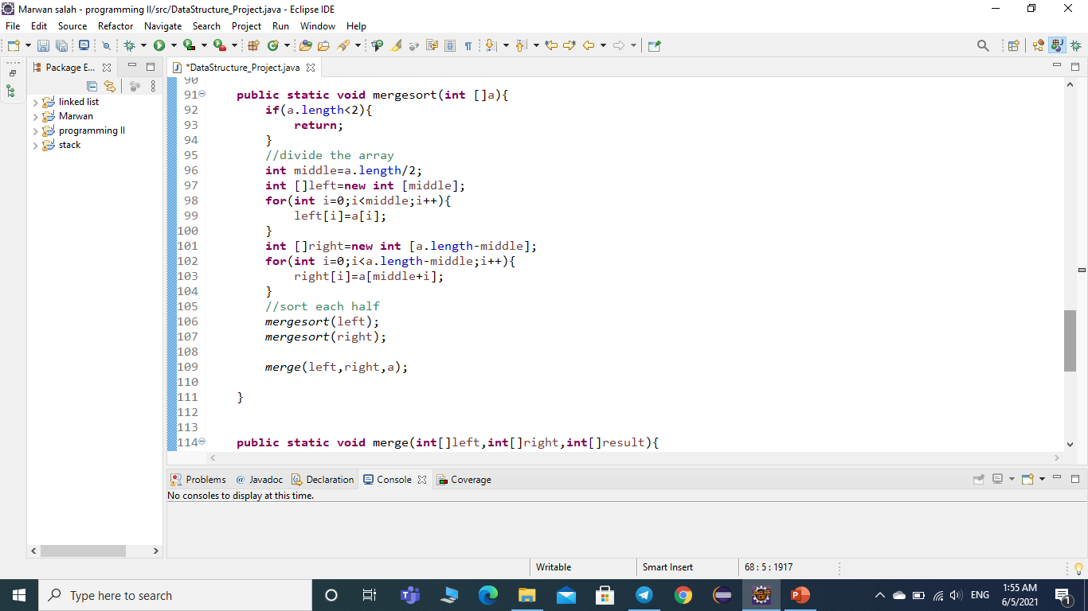

Slide 19
91)A static method that sorts array by using merge sort method (receives an array as parameter)
92)If condition states that if the length of the array less than 2
93)Return
96)Declaring a variable of type integer called “middle” equal to half the length of the array
97)An array named “left” with size “middle”
98)Filling the “left” array by using for loop until the middle of the Original array
101) An array named “right” with size “length of original array -middle”
98)Filling the “right” array by using for loop with the rest of elemnts in the Original array
106)Send “left” array to “mergesort” to sort it by recursion
107)Send “right” array to “mergesort” to sort it by recursion
109)Sending left and right and original array to be merged by using “merge” method

Slide 20
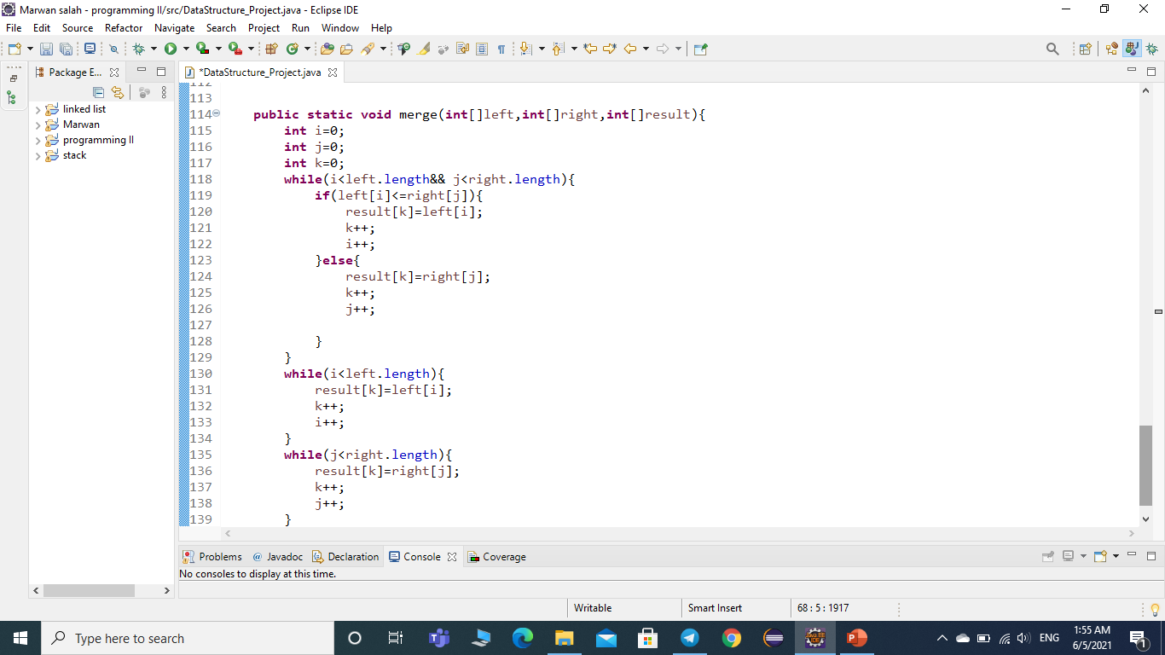

Slide 21
114)A static method named “merge” that receives (left array ,right array and original array) as parameters
115,116,117)declaring three integers I,j,k =0
118)While loop that is repeated as long as i<length of left array and j<length of right array
119)If condition stats that if element i in the left array smaller than or equal element j in right array
120)Assign element k in result array to element i in left
121)Increment k by 1
122)Increment I by 1
123)Else
124) Assign element k in result array to element j in right
125)Increment k by 1
126)Increment j by 1

Slide 22
130)While loop that is repeated as long as i less than length of the left array
131) Assign element k in result array to element i in left
132) increment k by 1
133)Increment I by 1
135) While loop that is repeated as long as j less than length of the right array
136) Assign element k in result array to element j in right
137) increment k by 1
138) increment j by 1

Slide 23
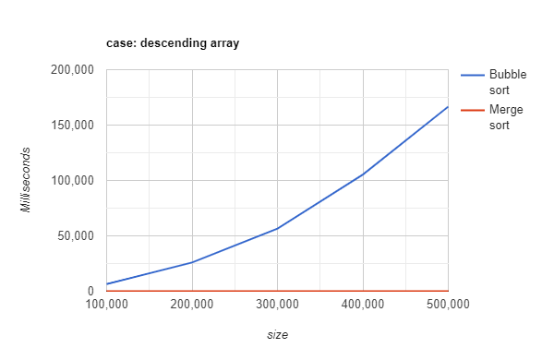
graphs
Test case: array in descending order

Slide 24
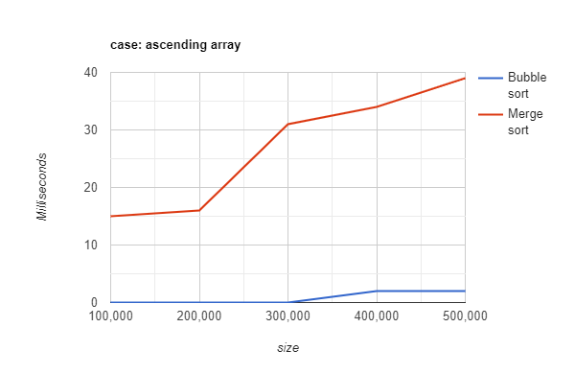
Test case: array in ascending order

Slide 25
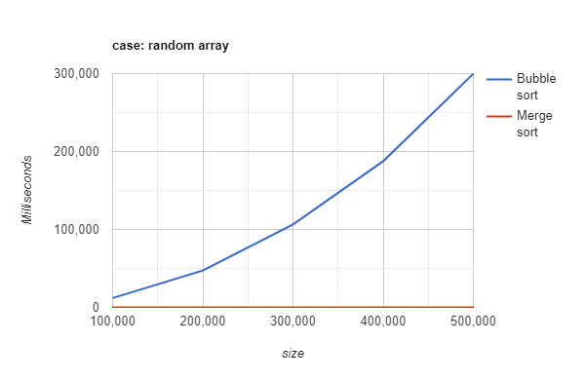
Test case: random array

Slide 26
Comparison between bubble sort and Merge sort
Which algorithm is best in time performance?
Point of comparison | Bubble sort | Merge sort
Best case | best | worst
Average case | worst | best
Worst case | worst | best

Slide 27
What is the Big o notations (time complexity) of each algorithm?
Point of comparison | Bubble sort | Merge sort
Best case | O(n) | O(n*log n)
Average case | O(n^2) | O(n*log n)
Worst case | O(n^2) | O(n*log n)
What is the space complexity of each algorithm?
Point of comparison | Bubble sort | Merge sort
Space complexity | O(1) | O(n)

Slide 28
Machine specification:
processor : intel core i7-10750H
processor base frequency : 2.60 GHZ
Max turbo frequency : 5.0 GHZ
number of threads : 12
cache : 12 MB (intel smart cache)
Bus speed : 8 GT/s
Memory : 16 GB
Storage : 256 GB (SSD),1 TB (HDD)

